Slide 1
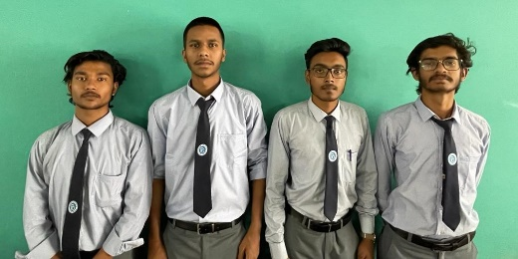

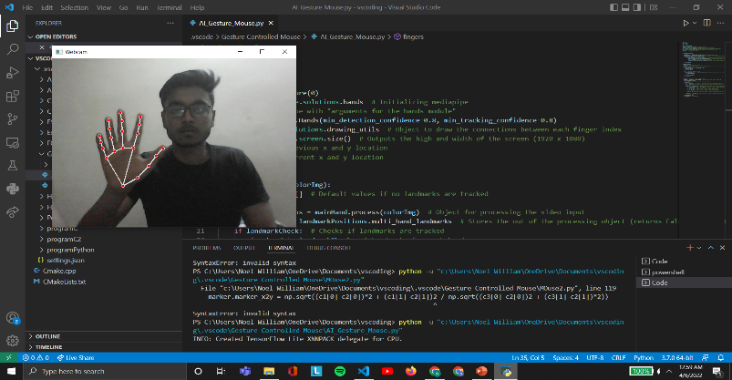
SCHOOL OF COMPUTER
SCIENCE & ENGINEERING
2021-22
AI Gesture Controlled Mouse
OBJECTIVE
PROJECT DIAGRAM
This Project can be implemented in Seminars and Presentations as we can control the cursor from a distance, and can it also be used for multitasking and many more. The AI virtual mouse system is has many objectives; it can be used to reduce the space for using the physical mouse, and it can be used in situations where we cannot use the physical mouse. The system eliminates the usage of devices, and it improves the human-computer interaction.
DETAILS OF INNOVATION
OUTCOME & FUTURE SCOPE
As we are watching the technology increasing day by day, we have been thinking to use Artificial Intelligence somewhere in our daily life. The main objective of the AI virtual mouse system is to control the mouse cursor functions by using the hand gestures instead of using a physical mouse. The proposed system can be achieved by using a webcam or a built-in camera which detects the hand gestures and hand tip and processes these frames to perform the particular mouse functions.This project uses our hand gesture to control the cursor of a mouse. We have used python programming language for this project.
We have successfully completed this project and we were able to use the mouse using a camera or a webcam.
This project has high future scope, as for multitasking this project can be high innovative. If the project is upgraded, we can use other parts of the body like face, legs to control a computer for seamless multitasking.
If implemented to hardware level, we can control machines on our finger tips and we can take artificial intelligence to next level.
After some modifications, this project can be used in professional Seminars and Presentations, as the presenter can control the powerpoint slides and other visual presentations from a distance.
GUIDED BY : TEAM MEMBERS :
Abhilasha Khandelwal Noel William, Aditya Rai, Anirban Biswas, Sanket Swaroop

